Slide 1
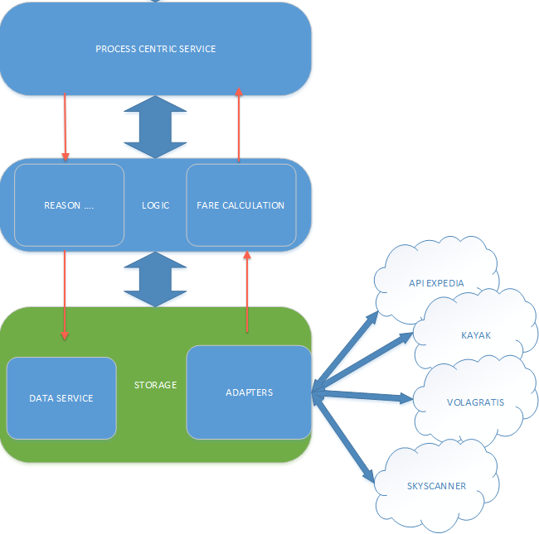

Slide 2
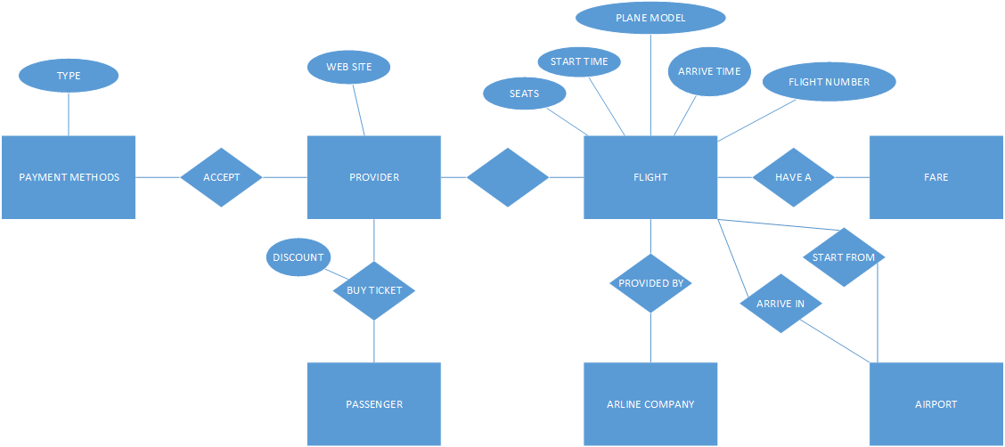

Slide 3
STORAGE SERVICE
REST
Adapter part: CrUd (creation and update over entities of external services)
Data service: CRUD on internal model (not the external entities)
All those exposed via logic in a trasparent way
For API selling expose only GET methods.
LOGIC SERVICE
REASONING:
Keep constrains by the processing centric service, expose services like filtering, matching, exceptions..
FARE CALCULATION:
Expose methods for getting the fare given a certain amount of constrains
PROCESS CENTRIC
SOAP
Main exposed services: from- to , #stops, maximum price, extra features, flexible

